Slide 1
Quality in Child Protection
Alicia Davis, J.D.
Principal Court Management Consultant
National Center for State Courts
Notes:
For several years, the Alaska AOC has been working to improve its case management system to improve data consistency and thus improve reporting capabilities. Susanne and Stefanie have a good understanding of the child welfare performance measures published by OJJDP. They have developed some individualized case management reports based on requests from judges. Stefanie has been working hard to provide clear instructions and training on data entry and how to use the case management system to manage the child welfare caseload. These efforts are producing measurable results. For the past year, they have been tracking all benchmark orders to ensure timely forwarding to the assigned judge. Before, reports would come in and would not be routed for signature, thus delaying entry of the order.
Imminent changes in the federal CIP grants, which include new requirements for data and measurable outcomes.

Slide 2
Why Measures Are Important To Courts
Public Accountability
Outcomes Achieved
Shared Resources
Hard Questions Asked
Notes:
The public hold both courts and child welfare agencies accountable for the outcomes of abused and neglected children. Data is one very tangible way to show the public how many children are in care, length of time in care, due process being completed appropriately, as well as what programs cost the population those programs serve.
You know if goals are being accomplished by the data you gather, if the outcome is what you expected it to be. Key word here is data. You have to know and understand where you are in order to know and understand if the reform effort you implemented worked.
Shared Resources – the resource I’m talking about is your time. Collaboration is the first and most important resource. While there are clear boundaries between what each of you do as individual stakeholders; so much of what you do depends on each other, the way to accomplish goals is through collaboration.
Toolkit Measures and Data propel courts, child welfare agencies and all the stakeholders into asking themselves and each other – “how can we most effectively serve the needs of the children and families? Are children and families receiving the services they need? And, are those services delivered in a fashion to produce the desired result?

Slide 3
Why Measures Are Important to Kids
no evidence of a diligent search in 41%
Only 46% had legal documentation to indicate that a permanency hearing was held within 1 year of coming into care
one in four APPLA cases did not have “compelling reasons” documented
90% of children did have a written transitional living plan but less than half were signed by the child
half (54%) of children had a documented relation- ship with an adult family member; another 24% had at least one connection to a non-familial adult
Notes:
When controlling for age, the 2009 Cold Case Review Group seemed to fare far better with respect to timely permanency than the 2008 Comparison Group for children aged 6 to 12 years old. The survival curve below indicates that within a year of the study, 26.8% of children aged 6 to 12 years old in the reviewed cohort were discharged to permanency, more than three times the rate of the 2008 Comparison Group (8.1%).

Slide 4
Why Measures Are Important to Kids
Notes:
When controlling for age, the 2009 Cold Case Review Group seemed to fare far better with respect to timely permanency than the 2008 Comparison Group for children aged 6 to 12 years old. The survival curve below indicates that within a year of the study, 26.8% of children aged 6 to 12 years old in the reviewed cohort were discharged to permanency, more than three times the rate of the 2008 Comparison Group (8.1%).

Slide 5
Continuous quality improvement
(1) due process of law
(2) timely, thorough and complete court hearings, and
(3) high quality legal representation to parents, children and the child welfare agency, both in and out of court.

Slide 6
https://www.ncjrs.gov/pdffiles1/ojjdp/223567.pdf

Slide 7
Importance of Toolkit Measures:
What gets measured gets done.
If you don’t measure results, you can’t tell success from failure.
If you can’t see success, you can’t reward it.
If you can’t reward success, you’re probably rewarding failure.
If you can’t see success, you can’t learn from it.
If you can’t recognize failure, you can’t correct it.
If you can demonstrate results, you can win public support.
Osbourne and Gaebler – 1992

Slide 8
9 Core Measures
Safety
Child safety while under court jurisdiction.
Permanency
Achievement of child permanency.
Due Process
Number of Judges per case.
Service of process to parties.
Timeliness
Child safety after release form court jurisdiction.
Time to permanent placement
Time to Adjudication
Time to first permanency hearing
Time to termination of parental rights petition

Slide 9
1. Time to First Permanency Hearing (Toolkit Measure 4G): The median time from the filing of the original petition to first permanency hearing (how long it takes to complete the first permanency hearing).

Slide 10
2. Time to all Subsequent Permanency Hearings (No Toolkit Measure Available): The median length of time in days between each subsequent permanency hearing that occurs until final permanency is achieved. For example, the number of days between the first permanency hearing and the second permanency hearing, the second permanency hearing and third, etc, for each hearing that occurs while the child remains in care.

Slide 11
3. Time to Permanent Placement (Toolkit Measure 4A): The median time from filing of the original petition to legal permanency (how long it takes for children in abuse and neglect cases to achieve legal permanency, following the filing of the original petition). “Legal Permanency” means that there is a permanent and secure legal relationship between the adult caregiver and the child, including reunification, adoption, legal guardianship or placement with a fit and willing relative.

Slide 12
4. Time to Termination of Parental Rights Petition (Toolkit Measure 4H): Where reunification has not been achieved, the median time from filing of the original petition to filing the petition to terminate parental rights (how long it takes from the date the original child abuse or neglect petition is filed to the date the termination of parental rights petition is filed).

Slide 13
5. Time to Termination of Parental Rights (Toolkit Measure 4I): Where reunification has not been achieved, the median time from filing of the original child abuse and neglect petition to the termination of parental rights (how long it takes from the date the original child abuse and neglect petition was filed to the date the termination of parental rights proceeding is completed).
Notes:
Examples of quality indicators include:
whether all parties received timely and adequate notice;
whether an ICWA inquiry was made;
whether court reports were filed in a timely manner pursuant to state statute or court rule;
whether family group conferencing or similar “out-of-court” processes enhancing family participation and engagement occurred;
whether language assistance services ( including, but not limited to court room interpreters) were provided to parties with limited English proficiency;
whether the court inquired about whether the parties reached agreement on any of the pending issues (did the court encourage cooperative, problem-solving approach to the extent possible);
whether a safety plan was ordered, presented or reviewed;
the presence of parents, children, legal counsel for parents or each parent, and the child’s attorney or GAL;
continuity of counsel in subsequent hearings;
the number of continuances granted;
the justification for continuances granted;
the length of the hearing;
whether testimony was taken and if so from whom;
whether the court consulted with the child;
whether any other type of evidence was received by the court and if so what (e.g., expert reports);
whether foster parents were present;
whether foster parents were told they had a right to be heard and were in fact heard;
whether extended family members and/or fictive kin were present;
whether extended family members and/or fictive kin were offered the opportunity to be heard;
whether the court made child well-being inquiries during the hearing (e.g., how the child is doing in school, how the child feels about his/her current placement, whether the child has any special needs, frequency and location of parent and sibling visitation, etc.);
whether specific inquires were made about the child’s developmental needs and the effects of trauma on the child were considered;
whether services ordered were trauma- informed and individually tailored to meet the developmental needs of the child;
the specificity of the court order, including whether the court order:
was detailed and case-specific,
contained a clearly identified permanency goal;
a concurrent goal;
for reunification cases, a date by when reunification will occur;
whether the court order addressed whether reasonable/active efforts were made;
whether the court order clearly identifies the parents’, child’s, or families’ responsibilities;
whether the court inquired about agency documentation that all other permanency goals have been ruled out in APPLA cases and:
whether the court made an inquiry regarding compelling reasons as to why a termination of parental rights petition has not been filed for children in care 15/22 months;
whether the compelling reason not to file for TPR has been specified in the court order;
whether the court order clearly identifies services to be provided to all parties;
whether all parties were provided a copy of the court order prior to leaving the courtroom;
whether the judge reviewed the order orally with the parties prior to ending the hearing;
whether counsel for all parties reviewed the court order with their respective clients prior to leaving the courtroom.

Slide 14
Colorado
Timeliness between key events
Changes in Placement
Permanency time frames and outcomes
Time between termination of parental rights and adoption
Attorney Appearance/Changes
Legal Counsel Received
Removals
Service of Process
Subsequent Petitions

Slide 15
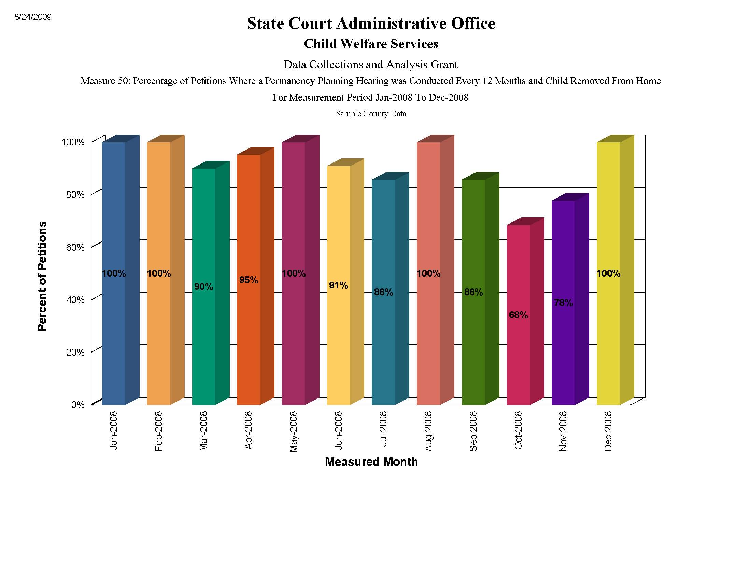
Michigan
I’d like to insert a snapshot photo of how

Slide 18
Hm.
Notes:
Questions raised:
Shared agreement on what data means
What level of data
Accuracy of data
Who maintains it
What measures are most relevant
What do judges and staff need?
Why are continuances occurring?
How to address issues as they arise?

Slide 19
Your Turn
Identify 1-2 areas needing reform efforts
What is the “problem?”
What is the intended change?
How will you know change has occurred?
If this “Change” occurs – what other unintended areas may be affected?
Identify the Toolkit Measures that could be used to monitor continuous improvement.
What challenges do you face with respect to obtaining and using measurement data? What are the solutions?
Brainstorm solutions to your challenges.
Report Back – YIKES!!!!!!

Slide 20
How do I get involved?
Vocalize your needs
Participate
Monitor Closely

